Slide 1


Nutan Maharashtra Vidya Prasarak Mandal’s NUTAN COLLEGE OF ENGINEERING AND RESEARCH Under Administrative Support of Pimpri Chinchwad Education Trust ISO 21001:2018 EOMS Certified
Seminar- II / Review -1
Presentation on
CortextGuard – Agentic AI cloud Misconfiguration portal
By
Vedant Thorat ( 43 )
Under the guidance of
Prof. Bhargavi Dalal
Academic Year 2025 - 26
Department of CSE-Artificial Intelligence

Slide 2
Nutan Maharashtra Vidya Prasarak Mandal’s NUTAN COLLEGE OF ENGINEERING AND RESEARCH Under Administrative Support of Pimpri Chinchwad Education Trust ISO 21001:2018 EOMS Certified
Seminar - II
Index
Introduction
Problem Statement
Problem Solution
System Requirements
Tools / Techniques used
Web Application Design / layout
Code screenshot
Output Screenshot till date

Slide 3

2. Introduction
Seminar - II
CortexGuard: AI-based platform for detecting and fixing cloud misconfigurations.
Problem: Cloud misconfigurations due to complexity and human errors.Importance of the project
Importance: Enables automated, proactive cloud security.

Slide 4
Problem Statement
Seminar - II
Problem: Cloud misconfigurations (e.g., open access, weak permissions) that expose systems to security risks.
Importance: These issues can lead to data breaches, financial loss, and system vulnerabilities, making automated security essential.

Slide 5
Objectives
Seminar - II
Main Aim: To design and develop an AI-based system (CortexGuard) for detecting and fixing cloud misconfigurations.
Objectives:
To improve cloud security and automation efficiency
To integrate DevSecOps for continuous protection
To provide a user-friendly monitoring and alert system

Slide 6
Literature Survey / Existing System
Seminar - II
AI improves cloud security using anomaly detection and pattern analysis
ML/DL techniques widely used for threat detection in cloud systems
DevSecOps integrates security into CI/CD with automation support
Traditional methods are slow, rule-based, and less effective for modern attacks

Slide 7
Proposed System
Seminar - II
AI-Powered Detection – Identifies cloud misconfigurations automatically
Agentic AI – Autonomous monitoring & decision-making
Auto-Remediation – Fixes issues without human input
DevSecOps Integration – Works within CI/CD pipelines
Real-Time Monitoring – Continuous cloud scanning
Multi-Cloud Support – AWS, Azure, GCP
Dashboard & Alerts – Centralized visibility
Compliance Checks – GDPR, ISO, SOC2

Slide 8
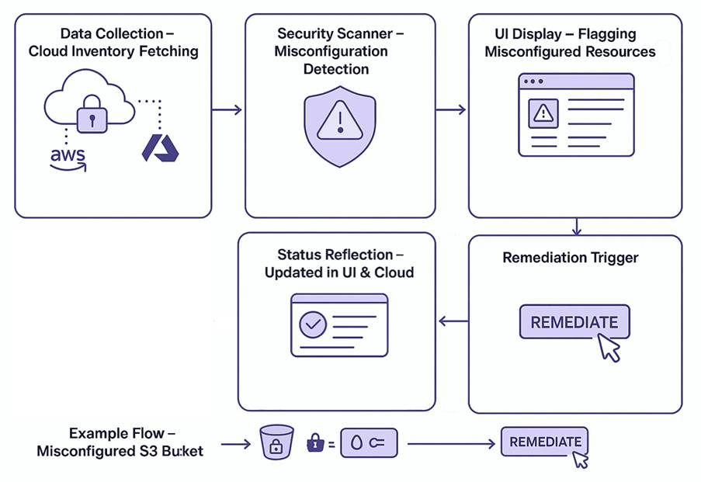
Methodology / System Architecture
Seminar - II
Working process of the project
Block diagram / architecture diagram
Flow of the system

Slide 9
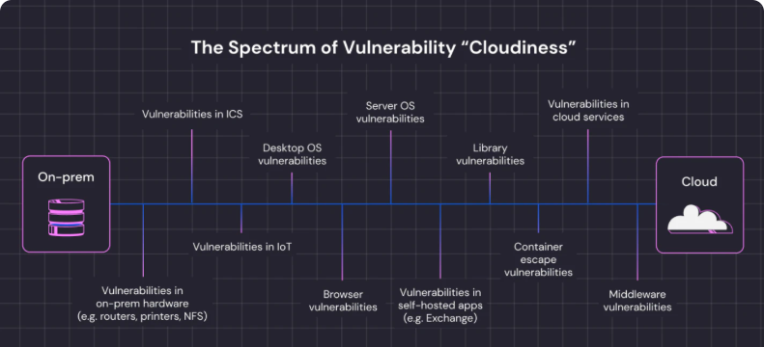
Seminar - II
9

Slide 10
Tools and Technologies Used
Seminar - II
Programming Language: Python, JavaScript
Database: MongoDB, MySQL
Platform: Jupyter Notebook / VS Code
Libraries / Frameworks used:
Backend: Node.js, FastAPI
Frontend: React.js
AI/ML: TensorFlow, Scikit-learn
Cloud SDKs: AWS SDK, Azure SDK

Slide 11
Implementation
Seminar - II
Requirement Analysis – Identify cloud security needs
System Design – Architecture & module planning
Tech Stack Setup – Install tools & frameworks
Frontend Development – Build dashboard (UI)
Backend Development – APIs & logic implementation
AI Model Integration – Detection & decision engine
Cloud Integration – Connect AWS/Azure/GCP APIs
Testing – Functional & security testing
Deployment – Docker/Kubernetes setup
Monitoring & Updates – Continuous improvement

Slide 12
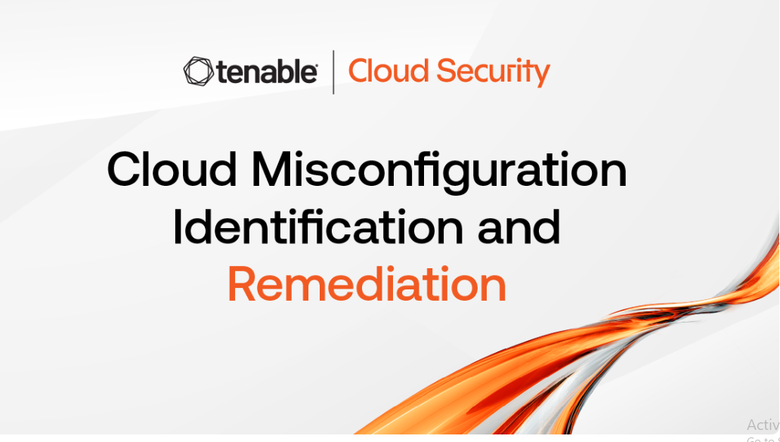
Seminar - II
Results / Output
12

Slide 13
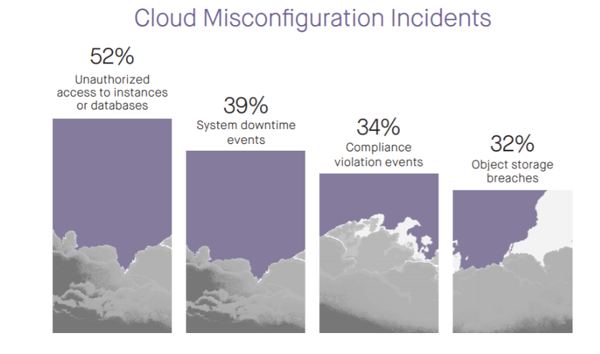
Results / Output
Seminar - II

Slide 14
Applications
Seminar - II
Cloud Security Automation – Automatically detect and fix misconfigurations in real-time
DevSecOps Integration – Embed security into CI/CD pipelines for safer deployments
IT & SaaS Companies – Multi-cloud infrastructure protection
Banking & Finance – Secure sensitive financial data in cloud systems

Slide 15
Advantages
Seminar - II
Automation – Reduces manual work, AI fixes issues automatically
Real-Time Detection – Instant identification of misconfigurations
Scalable – Works across multi-cloud environments
Improved Accuracy – Fewer false positives than traditional methods

Slide 16
Limitations
Seminar - II
Limited AI Training Data – Accuracy depends on the quality and amount of historical cloud configuration data
Cloud-Specific Dependencies – Some features may work differently across AWS, Azure, GCP
Resource Intensive – Continuous scanning and AI processing require significant computing power

Slide 17
Future Scope
Seminar - II
Enhanced AI Models – Use deep learning for more accurate misconfiguration detection
Predictive Analytics – Forecast potential security risks before they occur
Multi-Cloud Automation – Seamless support for AWS, Azure, GCP, and hybrid clouds
Customizable Remediation Policies – Let users define automated actions

Slide 18
Conclusion
Seminar - II
Automated Detection: AI identifies misconfigurations in real-time
Self-Healing System: Issues fixed automatically without manual intervention Improved Security: Reduced risk of breaches and human errors
DevSecOps Integration: Security embedded in CI/CD pipelines

Slide 19
References
Seminar - II
Detecting Security System Misconfiguration Threats in Cloud Computing Environments Using AI” – ResearchGate, 2023 “
Autonomous Threat Detection and Response in Cloud Security: AI-Driven Strategies” – Moonlight.io Survey, 2022
“Cloud Security Posture Management: A Comprehensive Review” – ScienceDirect, 2021
“DevSecOps Automation and AI Integration in Cloud Security” – IEEE, 2022

